Slide 1
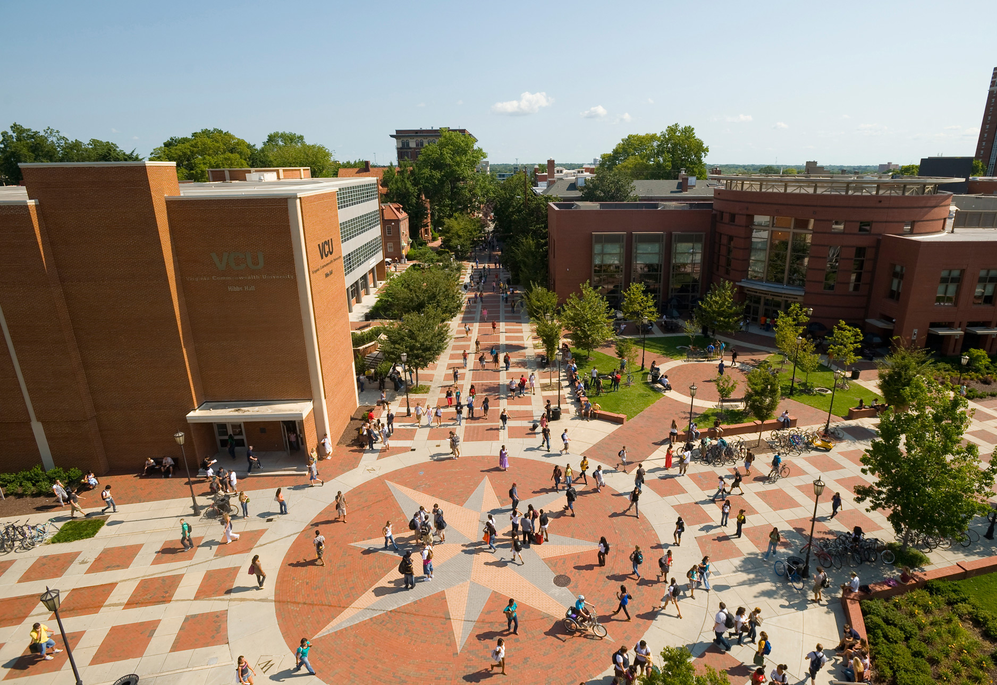


University Promotion and Tenure Task Force:
An Overview to Faculty Senate
February 2, 2021
Jill Gordon & Curt Sessler, Co-Chairs

Slide 2
Overview
Faculty representation
Charge from Provost Hackett
Organization of the Task Force
2

Slide 3
Faculty Representatives
K. Allison *
C. Amor
R. Brown
D. Coogan
T. Cropp
C. Cynn
Y. Edwards-Ingram
J. Gordon **
M. Gough
R. Hammack
R. Hurst
M. Johnson
G. Kellogg
K. Kester *
J. Khoury
P. Knapp *
S. Kye Price *
C. Lafazami
S. Liebert
J. Murray
M. Peters
E. Ripley *
H. Rozycki *
K. Rudasill
N. Russell
C. Sessler **
R. Sterling *
E. Welleford
L. Zyzniewski *
** Task Force Co-Chairs * Sub-committee Co-Chairs
3

Slide 4
Charge from Provost Hackett
Focus is on tenured and tenure track faculty due to Term Report.
Focus on both policy and procedural items.
Develop guidance on tenured faculty promotion to full professor via teaching.
Goal is to make recommendations not write policy.
Seek input for other areas to consider.
4

Slide 5
Organization & Input
Subcommittees
  Teaching
  Research
  Service
  Policy
Survey of Faculty
https://provost.vcu.edu/faculty/faculty-resources/taskforce
5

Slide 6
Questions?

